Slide 1
W4111 – Introduction to Databases Section 002, Spring 2021 Lecture 7: ER, Apps, SQL, Projects
© Donald F. Ferguson, 2021

Slide 2
W4111 – Introduction to Databases Section 002, Spring 2021 Lecture 7: ER, Apps, SQL, Projects
We will start in a couple of minutes.
© Donald F. Ferguson, 2021

Slide 3

Contents and Agenda
3 | COMS W4111_002_2021_1: Lecture 7: ER, Apps, SQL, Projects © Donald F. Ferguson, 2021

Slide 4
Contents
Questions, comments, discussion.

Slide 5
HW3 and HW4 – Incremental Project My Example
5 | COMS W4111_002_2021_1: Lecture 7: ER, Apps, SQL, Projects © Donald F. Ferguson, 2021

Slide 6

My HW3 and HW4 Project Concept
6 | COMS W4111_002_2021_1: Lecture 7: ER, Apps, SQL, Projects © Donald F. Ferguson, 2021

Slide 7
Pretend to Play Fantasy Baseball
My example projects for the two tracks will be a simple fantasy baseball solution.
“Fantasy baseball is a game in which people manage rosters of league baseball players, either online or in a physical location, using fictional fantasy baseball team names. The participants compete against one another using those players' real-life statistics to score points.”
My solution will have two subsystems:
Analysis system:
Read only data that enables people to select players based on performance, and to estimate the performance of their fantasy team.
Event based update system that changes analysis data based on new data.
Operational system that manages create, retrieve update, delete, etc. of their fantasy teams and leagues.
INSERT, UPDATE, DELETE primarily apply to the operational system.

Slide 8


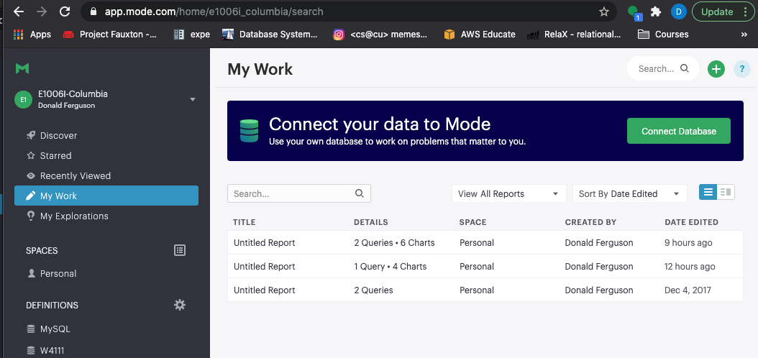

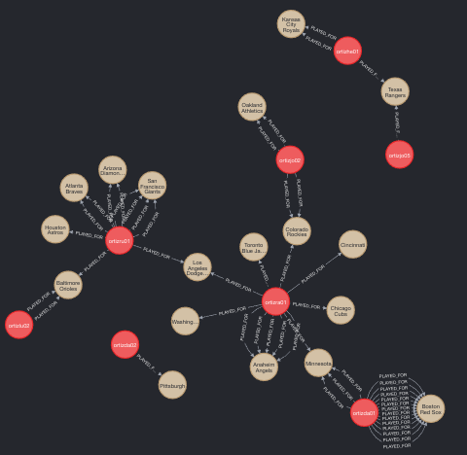
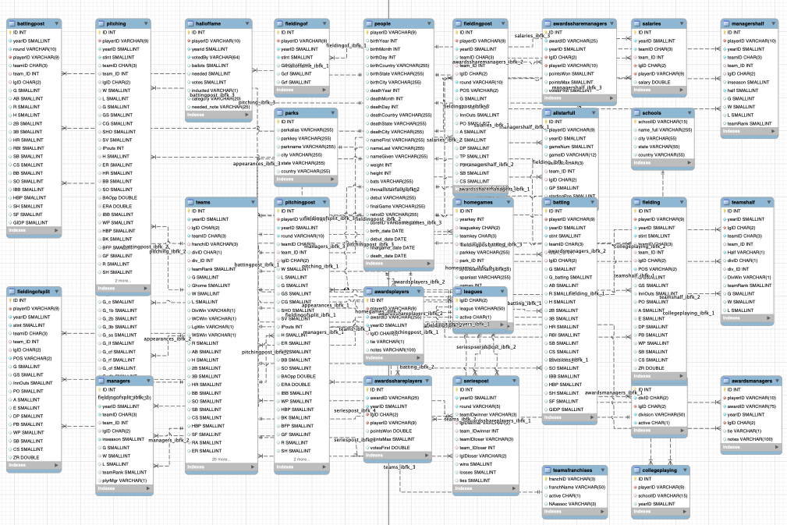
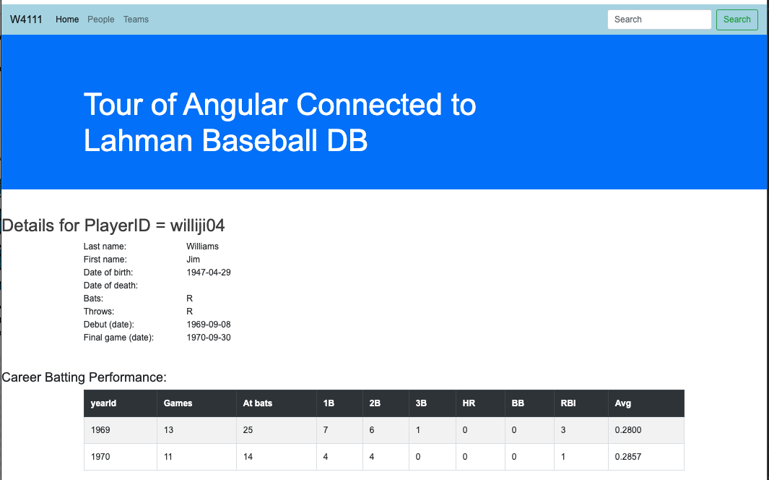
Target Application/Project(s) – Reminder (Lecture 1)
Data Insight Service
Data Lake
Web Application
Social Network Service
DB Access Service
Core Data Service
Comment Discussion Service

Slide 9
Target Application/Project – Reminder (Lecture 1)
That diagram was pretty confusing.
Basically, what it comes down to is that there will be major subsystems:
Interactive web application for viewing, navigating and updating data. The updates have to preserve semantic constraints and correctness.
A decision support warehouse/lake that allows us to explore data and get insights.
Programming and non-programming tracks will get experience with both, but
Non-programming track focuses on data engineering needed to produce (2).
Programming track will focus on (1).
The example that I will use is fantasy baseball because it covers both aspects, and there is a lot of interesting data available.
You will have some freedom on the data models and scenarios you choose.

Slide 10
Operational System (Web Application)
10 | COMS W4111_002_2021_1: Lecture 7: ER, Apps, SQL, Projects © Donald F. Ferguson, 2021

Slide 11
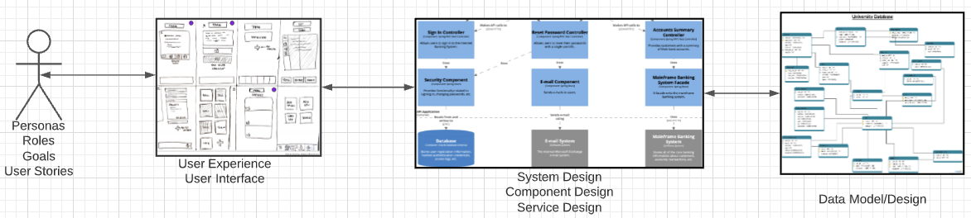
Problem Statement – Modified (Lecture 1 Reminder)
We must build a system that supports ... ... operations in a ... ...
We will design, develop, test and deploy the system iteratively and continuously.
There are four core domains.
The processes are iterative, with continuous extension and details.
We will start implementing various user stories. Implementation requires:
Web UI
Paths
Data model and operations.
In this course,
We focus on the data dimension.
We will get some insight into the other dimensions.

Slide 12
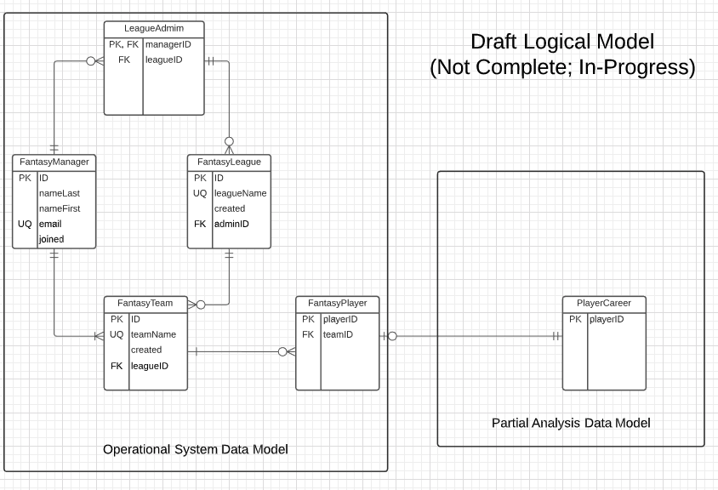
In-Progress Operational System Data Model

Slide 13
Web Application – Operational System
Lahman’s Baseball DB
Fantasy Baseball DB

Slide 14
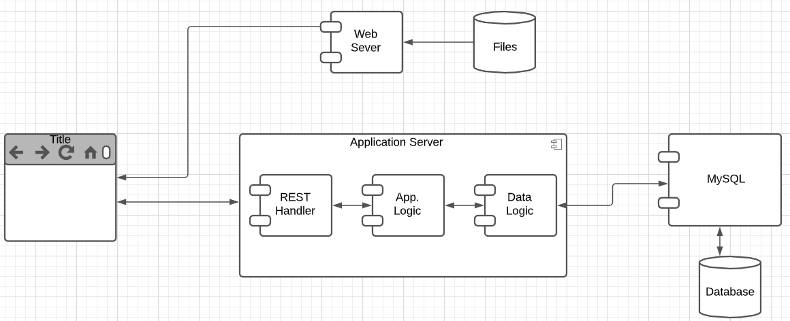
User Story
“In software development and product management, a user story is an informal, natural language description of one or more features of a software system. User stories are often written from the perspective of an end user or user of a system. ” (https://en.wikipedia.org/wiki/User_story)
Example user stories that I need to implement for the operational system:
”As a fantasy team manager, I want to search for players based on career stats.”
“As a fantasy team manager, I want to add a player to my fantasy team.
etc.
I need to implement:
UI
Application logic
Database tables.

Slide 15
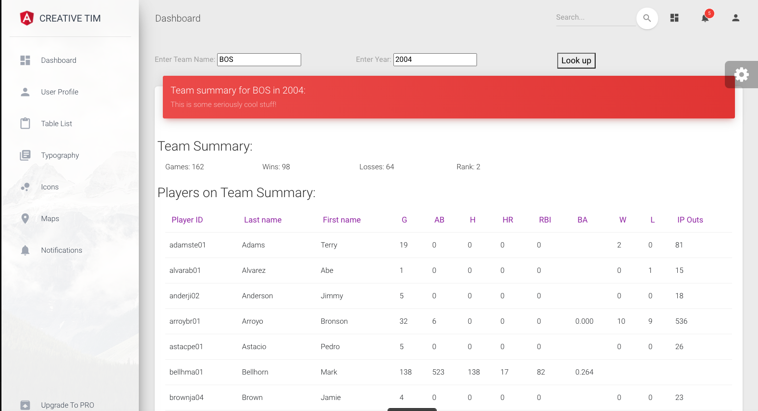
Simple Example
Web Application
MySQL
Two HTTP/REST calls:
GET /api/team_summary?team_id=BOS&year_id=2004
GET /api/teams?teamID=BOS&yearID=2004
Two SQL Queriess:
SELECT to Teams table.
SELECT to team_summary, which is a view. We cover views later.
“As a baseball fan, I want to enter a teamID and yearID and see:
Team wins and losses.
Summary of player performance for players on the team and year.”
Built:
Dashboard page.
REST handlers and application logic.
Database view.
Tracks will build:
Programming: Mix of CRUD and dashboard.
Non-programming: Dashboards, Data transformation.
Will see more details as we move forward.

Slide 16
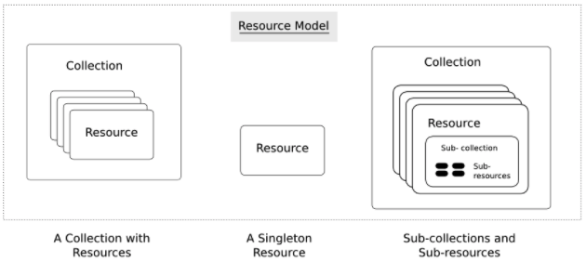
Simple Example – Fantasy Team Resource
https://restful-api-design.readthedocs.io/en/latest/resources.html
Interaction flow is right-to-left in this diagram.
Resources: (https://restful-api-design.readthedocs.io/en/latest/resources.html)
The fundamental concept in any RESTful API is the resource. A resource is an object with a type, associated data, relationships to other resources, and a set of methods that operate on it.
... ... information that describes available resources types, their behavior, and their relationships the resource model of an API. The resource model can be viewed as the RESTful mapping of the application data model.
APIs:
... ... APIs expose functionality of an application or service that exists independently of the API. (DFF comment – the data)
Understanding enough of the important details of the application for which an API is to be created, so that an informed decision can be made as to what functionality needs to be exposed ... ...
Modeling this functionality in an API that addresses all use cases that come up in the real world ... ...

Slide 17
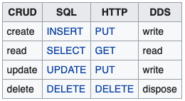
CRUD (https://en.wikipedia.org/wiki/Create,_read,_update_and_delete)
Definitions:
“In computer programming, create, read, update, and delete[1] (CRUD) are the four basic functions of persistent storage.”
“The acronym CRUD refers to all of the major functions that are implemented in relational database applications. Each letter in the acronym can map to a standard Structured Query Language (SQL) statement, Hypertext Transfer Protocol (HTTP) method (this is typically used to build RESTful APIs[5]) or Data Distribution Service (DDS) operation.”
Do not worry about Data Distribution Service.
For our purposes HTTP – REST
Entity Set:
Table in SQL
Collection Resource in REST.
Entity:
Row in SQL
Resource in REST

Slide 18
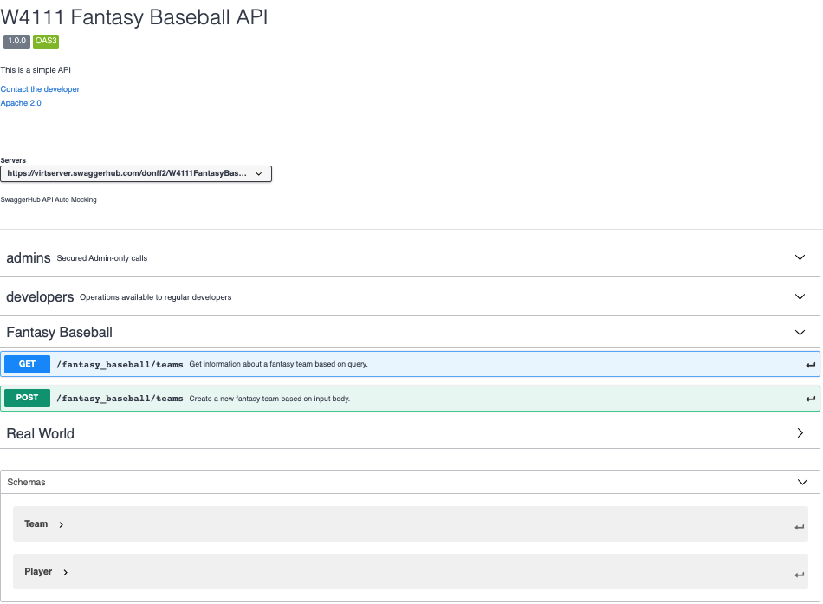
REST API Definition
“A REST API is a way for two computer systems to communicate over HTTP in a similar way to web browsers and servers. Sharing data between two or more systems has always been a fundamental requirement of software development.)
“Like any other architectural style, REST also does have it’s own 6 guiding constraints which must be satisfied if an interface needs to be referred as RESTful.”
Open API Definition
API Tags/Groupings
A resource has
Paths
Methods
Schema (Data Formats)
Sent on POST and PUT
Returned on GET
This material is just FYI and to help with understanding concepts, mapping to DB, ...

Slide 19
Demo
API: https://app.swaggerhub.com/apis/donff2/W4111FantasyBaseball/1.0.0#/
Starter API project:
App (Postman) http://127.0.0.1:5000/api/fantasy_team/BOS20011
Project: ~/Dropbox/Columbia/W4111_S21_New/W4111S21/Projects/FantasyBaseball

Slide 20
Operational System (Web Application)
20 | COMS W4111_002_2021_1: Lecture 7: ER, Apps, SQL, Projects © Donald F. Ferguson, 2021

Slide 21
Analysis System – Fantasy Baseball Concept
Focus is on the Analysis Data System (Primary Focus):
Data Lake is source data, imported and added to common database/model. (e.g. Lahman Baseball DB)
Analysis data is transformed data suitable for analysis, and analysis results. (e.g. Transformed Lahman’s Data)
Various analysis and processing tools use the data for insight, visualization, etc. (e.g. Jupyter, Pandas)
Analysis and Processing Tools System
Results Reports
Analysis Data System
Data
Transform
And Load Processes
Analysis Data
Transformed for analysis. Analyzed and derived information.
Data Lake
Loaded, unprocessed Original input data.
Data/Schema Transform

Slide 22
Data Lake to Analysis Data
This is a database class. So, the raw data to analysis data is a focus.
Consider the following requirement.
I want to be able to predict a player’s performance relative to salary based on history.
The first step is joining information from several tables, e.g.
Appearances.
Batting.
Pitching.
Fielding.
Salary.
We then need to produce a single summary/prediction row. But, this is not as simple as just summing and averaging.
A year’s numbers may be low because the player was injured and did not play many games.
The average is not meaningful. Over their career, player’s get better and then worse. We want to use averages for historical players but trends for active players.
Salary data is missing. Average salary changed over time and we need to normalize.
Absolute numbers do not matter. What matters is relative performance to other players.
Let’s just do a very simple example. Career summary of annual performance relative to averages.

Slide 23
Comments and Observations
23 | COMS W4111_002_2021_1: Lecture 4: ER, Relational, SQL (IV) © Donald F. Ferguson, 2021

Slide 24
Analysis System
24 | COMS W4111_002_2021_1: Lecture 4: ER, Relational, SQL (IV) © Donald F. Ferguson, 2021

Slide 25
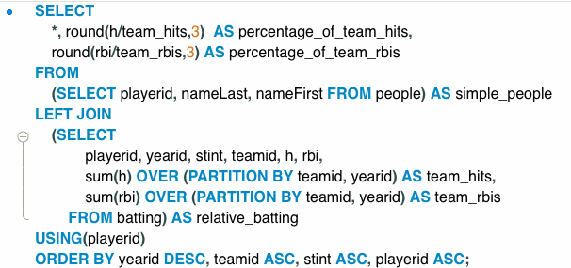
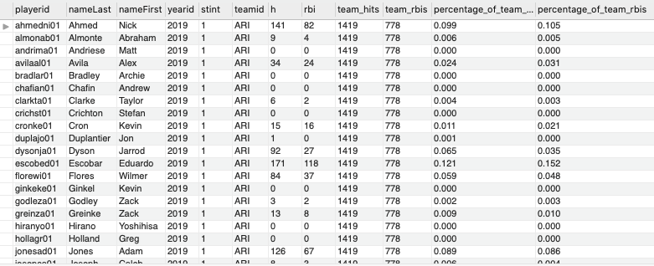
Secret Advanced SQL – Window Function
”As a fan, I want a table that has player information, a player’s H and RBI per year, stint and team, and shows the player’s H and RBI as a percentage of the team’s totals.
I cannot easily do this with a GROUP BY
I want a row for each playerID, yearID, stint and team showing the individual performance.
GROUP BY reduces the number of rows to the distinct groups.
What I want is the individual rows that also has columns containing data produced by GROUP BY.
This is a combination of Window functions (like aggregation) and partition (like GROUP BY).
(Switch to Notebook)

Slide 26
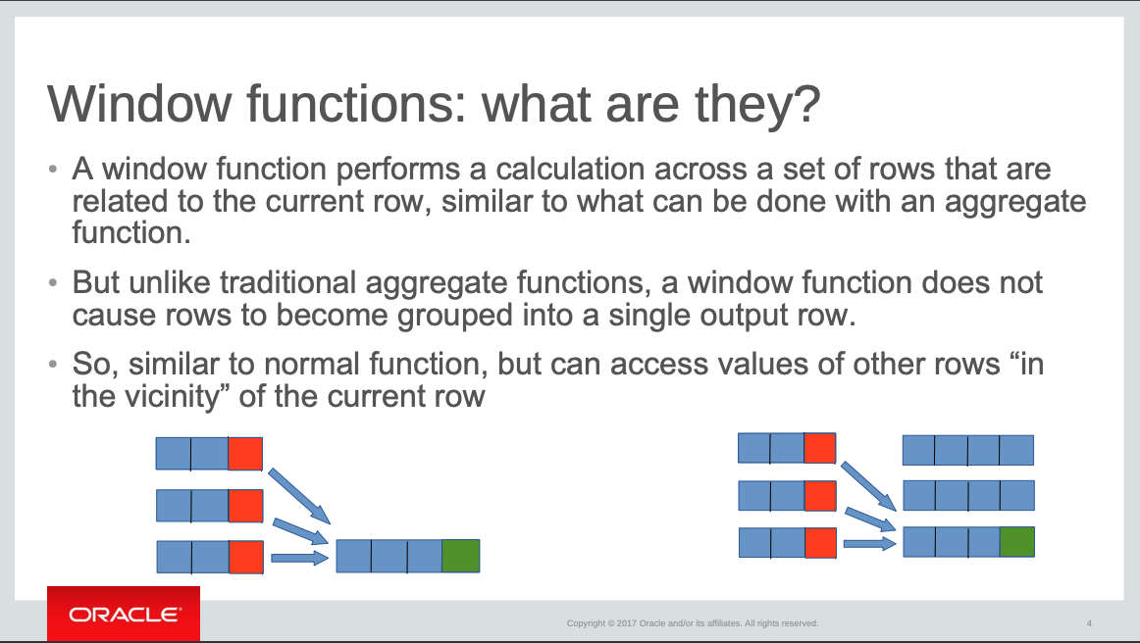
Concepts (https://www.slideshare.net/DagHWanvik/sql-window-functions-for-mysql)

Slide 27
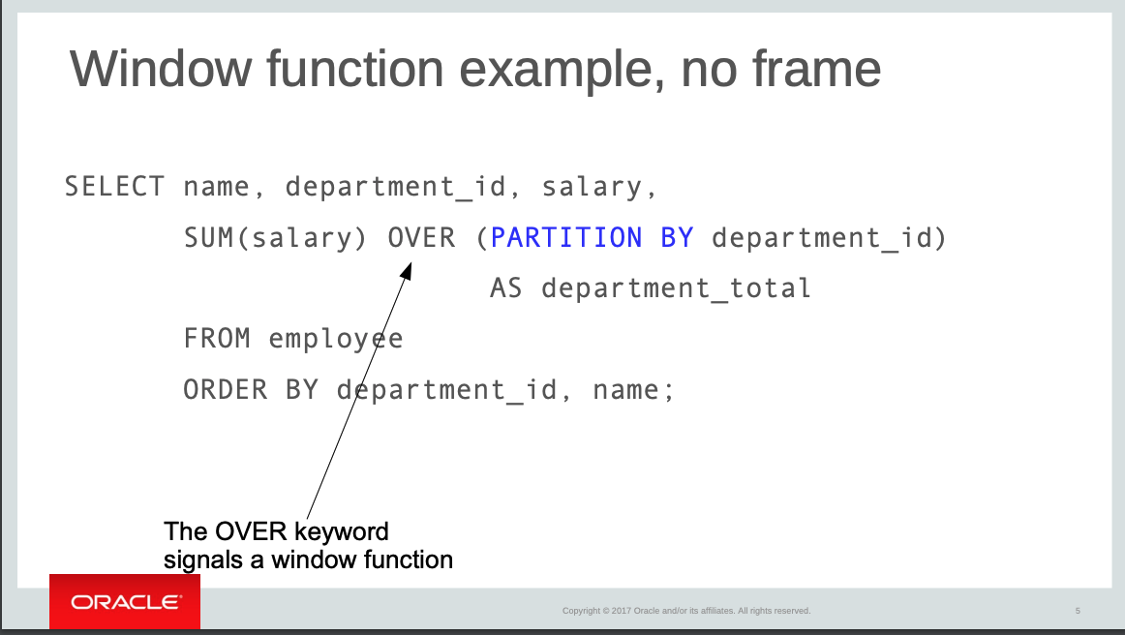
Concepts (https://www.slideshare.net/DagHWanvik/sql-window-functions-for-mysql)

Slide 28
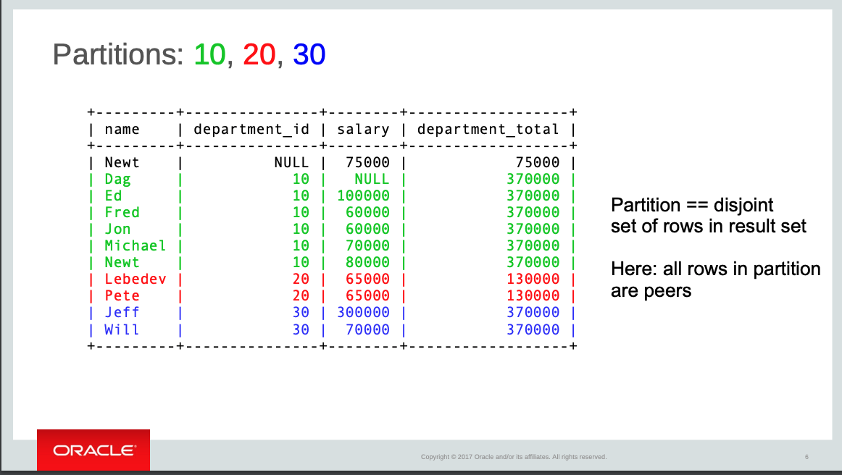
Concepts (https://www.slideshare.net/DagHWanvik/sql-window-functions-for-mysql)

Slide 29
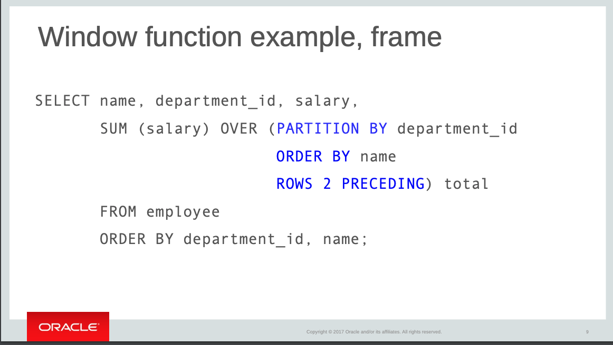
Concepts (https://www.slideshare.net/DagHWanvik/sql-window-functions-for-mysql)

Slide 30
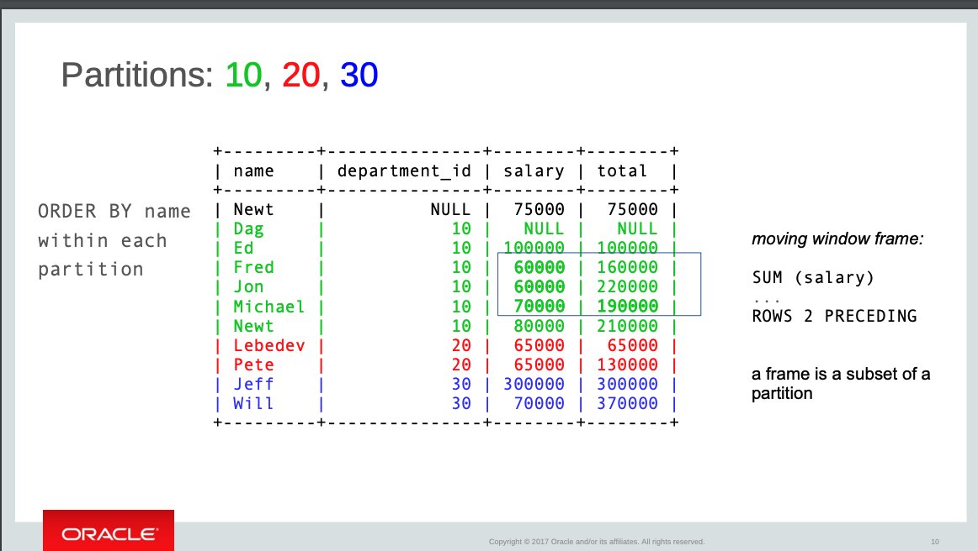
Concepts (https://www.slideshare.net/DagHWanvik/sql-window-functions-for-mysql)

Slide 31
Some "Nastily Exhausting Wizarding Tests (N.E.W.T.)" Level Stuff
Observations:
This is some serious wizard stuff.
It is not on the core, recommended department syllabus for SQL.
The feature is new in MySQL 8.0, and relatively new in all SQL products.
There are inconsistencies between the various SQL products.
And, Pandas also has similar functions.
Why do we cover this ...?
It is really cool and useful.
The capability is extremely useful for data science, machine learning, etc.
The TAs love to ask questions on this stuff ...

Slide 32
__get_access_path__(self, fields)
32 | COMS W4111_002_2021_1: Lecture 4: ER, Relational, SQL (IV) © Donald F. Ferguson, 2021

Slide 33
__get_access_path__(self, fields)
Implement __get_access_path__
What are talking about?

Slide 34
Access Path
Every relational operator accepts one or more tables as input. The operator “accesses the tuples” in the tables.
There are two “ways” to retrieve the relevant tuples
Scan the relation (via blocks)
Use an index and matching condition.
A selection (WHERE) condition is in conjuctive normal form if
Each term is column_name op value
op is one of <, <=, =, >, >=, <> (or =, != for Hash Index)
The terms are ANDed, e.g. (nameLast = ‘Ferguson’) AND (ab > 500)
CNF allows using a matching index for the access path.
The engine can select a matching index
A Hash Index on (c1,c2,c3) if the condition is c1=x AND c2=y AND c3=z.
A Tree Index if the condition is (can be ordered as)
c1 op value
c1 op x AND/OR c2 op y
… …
Many indexes may match, and the engine chooses the most selective match (number of tuples or blocks) that match.
HW 2 implements simple indexes using dictionaries.
Dictionaries use hash indexes.

Slide 35
Some More on Changing Data
35 | COMS W4111_002_2021_1: Lecture 4: ER, Relational, SQL (IV) © Donald F. Ferguson, 2021

Slide 36
Basic INSERT, UPDATE, DELETE
36 | COMS W4111_002_2021_1: Lecture 4: ER, Relational, SQL (IV) © Donald F. Ferguson, 2021

Slide 37
Updates to tables
Insert
insert into instructor values ('10211', 'Smith', 'Biology', 66000);
Delete
Remove all tuples from the student relation
delete from student
Drop Table
drop table r
Alter
alter table r add A D
where A is the name of the attribute to be added to relation r and D is the domain of A.
All exiting tuples in the relation are assigned null as the value for the new attribute.
alter table r drop A
where A is the name of an attribute of relation r
Dropping of attributes not supported by many databases.

Slide 38
Modification of the Database
Deletion of tuples from a given relation.
Insertion of new tuples into a given relation
Updating of values in some tuples in a given relation

Slide 39
Deletion
Delete all instructors
delete from instructor
Delete all instructors from the Finance department delete from instructor where dept_name= 'Finance’;
Delete all tuples in the instructor relation for those instructors associated with a department located in the Watson building.
delete from instructor where dept name in (select dept name from department where building = 'Watson');

Slide 40
Deletion (Cont.)
Delete all instructors whose salary is less than the average salary of instructors
Problem: as we delete tuples from instructor, the average salary changes
Solution used in SQL:
First, compute avg (salary) and find all tuples to delete
Next, delete all tuples found above (without recomputing avg or retesting the tuples)
delete from instructor
where salary < (select avg (salary)
from instructor);

Slide 41
Insertion
Add a new tuple to course
insert into course values ('CS-437', 'Database Systems', 'Comp. Sci.', 4);
or equivalently
insert into course (course_id, title, dept_name, credits) values ('CS-437', 'Database Systems', 'Comp. Sci.', 4);
Add a new tuple to student with tot_creds set to null
insert into student values ('3003', 'Green', 'Finance', null);
The base format is INSERT INTO table_name (c1, c2, ..., cn) values (v11, v12, ..., v1n), (v21, v22, ..., v2n), ...
c1, c2, ... is a list of column names in any order.
(vi1, vi2, ... is a list of the corresponding column values.
There is also INSERT INTO table_name (c1, c2, ..., cn) SELECT ... ..., where the select statement produces a table compatible with the column list.

Slide 42
Insertion (Cont.)
Make each student in the Music department who has earned more than 144 credit hours an instructor in the Music department with a salary of $18,000.
insert into instructor select ID, name, dept_name, 18000 from student where dept_name = 'Music' and total_cred > 144;
The select from where statement is evaluated fully before any of its results are inserted into the relation.
Otherwise queries like
insert into table1 select * from table1
would cause problem

Slide 43
Updates
Give a 5% salary raise to all instructors
update instructor set salary = salary * 1.05
Give a 5% salary raise to those instructors who earn less than 70000 update instructor set salary = salary * 1.05 where salary < 70000;
Give a 5% salary raise to instructors whose salary is less than average
update instructor set salary = salary * 1.05 where salary < (select avg (salary) from instructor);

Slide 44
Updates (Cont.)
Increase salaries of instructors whose salary is over $100,000 by 3%, and all others by a 5%
Write two update statements:
update instructor set salary = salary * 1.03 where salary > 100000; update instructor set salary = salary * 1.05 where salary <= 100000;
The order is important
Can be done better using the case statement (next slide)

Slide 45
Case Statement for Conditional Updates
Same query as before but with case statement
update instructor set salary = case when salary <= 100000 then salary * 1.05 else salary * 1.03 end

Slide 46
Updates with Scalar Subqueries
Recompute and update tot_creds value for all students
update student S set tot_cred = (select sum(credits) from takes, course where takes.course_id = course.course_id and S.ID= takes.ID.and takes.grade <> 'F' and takes.grade is not null);
Sets tot_creds to null for students who have not taken any course
Instead of sum(credits), use:
case when sum(credits) is not null then sum(credits) else 0 end

Slide 47
Summary
INSERT, UPDATE and DELETE are pretty straightforward.
UPDATE and DELETE are very similar to SELECT
WHERE clause specifies which rows are affected.
The SELECT choose the columns to return.
The SET clause chooses and changes columns.
DELETE just removes the specified rows.
INSERT, UPDATE and DELETE changes must not violate constraints, e.g.
INSERT a row that causes a duplicate key.
DELETE a referenced (target) foreign key.
UPDATE columns that create a duplicate key.
INSERT values do not include all NOT NULL columns.
I am not going to do example now, but you have seen and will see me do examples in the context of larger examples.

Slide 48
Examples
48 | COMS W4111_002_2021_1: Lecture 4: ER, Relational, SQL (IV) © Donald F. Ferguson, 2021

Slide 49
Pretend to Play Fantasy Baseball
My example projects for the two tracks will be a simple fantasy baseball solution.
“Fantasy baseball is a game in which people manage rosters of league baseball players, either online or in a physical location, using fictional fantasy baseball team names. The participants compete against one another using those players' real life statistics to score points.”
My solution will have two subsystems:
Analysis system:
Read only data that enables people to select players based on performance, and to estimate the performance of their fantasy team.
Event based update system that changes analysis data based on new data.
Operational system that manages create, retrieve update, delete, etc. of their fantasy teams and leagues.
INSERT, UPDATE, DELETE primarily apply to the operational system.

Slide 50
In-Progress Operation System Data Model

Slide 51
Problem Statement – Modified Reminder
We must build a system that supports academic operations in a university.
We will design, develop, test and deploy the system iteratively and continuously.
There are four core domains.
The processes are iterative, with continuous extension and details.
We will start implementing various user stories. Implementation requires:
Web UI
Paths
Data model and operations. (Will only cover this now).
In this course,
We focus on the data dimension.
We will get some insight into the other dimensions.

Slide 52
Web Application
IMDB Database
It would be “cool” if we
could look at the data directly!

Slide 53
User Story
“In software development and product management, a user story is an informal, natural language description of one or more features of a software system. User stories are often written from the perspective of an end user or user of a system. ” (https://en.wikipedia.org/wiki/User_story)
Example user stories that I need to implement for the operational system:
”As a fantasy team manager, I want to search for players based on career stats.”
“As a fantasy team manager, I want to add a player to my fantasy team.
etc.
I need to implement:
UI
Application logic
Database tables.

Slide 54
Simple Example
Web Application
MySQL
Two HTTP/REST calls:
GET /api/team_summary?team_id=BOS&year_id=2004
GET /api/teams?teamID=BOS&yearID=2004
Two SQL Queriess:
SELECT to Teams table.
SELECT to team_summary, which is a view. We cover views later.
“As a baseball fan, I want to enter a teamID and yearID and see:
Team wins and losses.
Summary of player performance for players on the team and year.”
Built:
Dashboard page.
REST handlers and application logic.
Database view.
Tracks will build:
Programming: Mix of CRUD and dashboard.
Non-programming: Dashboards, Data transformation.
Will see more details as we move forward.

Slide 55
Switch to Notebook
Switch to Notebook and Code.
Angular project
OpenAPI
Application code

Slide 56
Common Table Expressions
56 | COMS W4111_002_2021_1: Lecture 4: ER, Relational, SQL (IV) © Donald F. Ferguson, 2021

Slide 57
With Clause
The with clause provides a way of defining a temporary relation whose definition is available only to the query in which the with clause occurs.
Find all departments with the maximum budget with max_budget (value) as (select max(budget) from department) select department.name from department, max_budget where department.budget = max_budget.value;

Slide 58
Complex Queries using With Clause
Find all departments where the total salary is greater than the average of the total salary at all departments
with dept _total (dept_name, value) as
(select dept_name, sum(salary)
from instructor
group by dept_name),
dept_total_avg(value) as
(select avg(value)
from dept_total)
select dept_name
from dept_total, dept_total_avg
where dept_total.value > dept_total_avg.value;

Slide 59
Common Table Expressions
CTE: (https://www.essentialsql.com/introduction-common-table-expressions-ctes/)
“The Common Table Expressions or CTE’s for short are used within SQL (...) to simplify complex joins and subqueries, ...”
“A CTE (Common Table Expression) defines a temporary result set which you can then use in a SELECT statement. It becomes a convenient way to manage complicated queries.”
There are two types of CTEs:
Non-recursive.
Recursive (note, recursive SQL weirds me out).
The benefits are clarity and improved quality through incremental development.
Basic syntax by example.
There may be several CTEs.
A CTE can reference other CTEs.

Slide 60
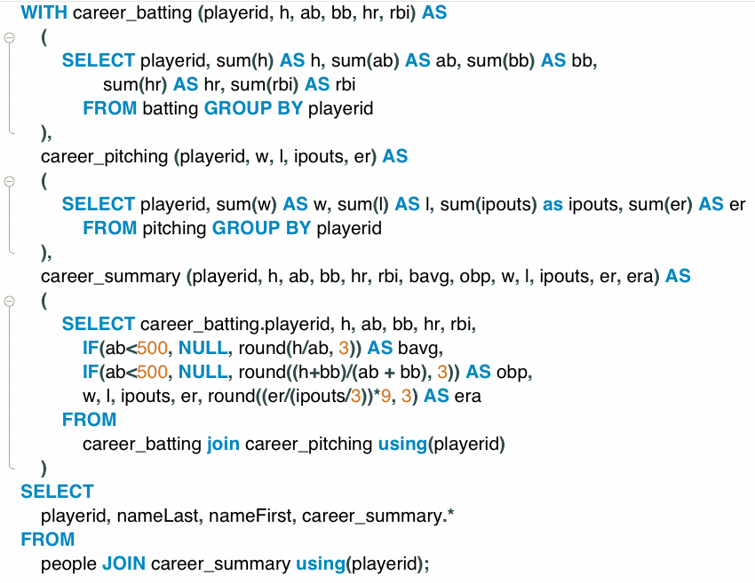
Common Table Expressions – Example
Producing a career summary requires several tasks:
Computing batting totals
Computing pitching totals
Applying formulas to produce derived averages and metrics.
Joining (1), (2) and (3) into a career summary.
Joining with people to bring in personal information.
Producing the table is possible with a single SELECT statement, but ... ...
Developing incrementally one simpler query at a time is easier.
The resulting query is easier to understand and maintain.

Slide 61
Views
61 | COMS W4111_002_2021_1: Lecture 4: ER, Relational, SQL (IV) © Donald F. Ferguson, 2021

Slide 62
Views
In some cases, it is not desirable for all users to see the entire logical model (that is, all the actual relations stored in the database.)
Consider a person who needs to know an instructors name and department, but not the salary. This person should see a relation described, in SQL, by select ID, name, dept_name from instructor
A view provides a mechanism to hide certain data from the view of certain users.
Any relation that is not of the conceptual model but is made visible to a user as a “virtual relation” is called a view.

Slide 63
View Definition
A view is defined using the create view statement which has the form
create view v as < query expression >
where <query expression> is any legal SQL expression. The view name is represented by v.
Once a view is defined, the view name can be used to refer to the virtual relation that the view generates.
View definition is not the same as creating a new relation by evaluating the query expression
Rather, a view definition causes the saving of an expression; the expression is substituted into queries using the view.
I created a view that summarizes player performance by team and year.
This requires GROUP BY to eliminates stints and JOIN.

Slide 64
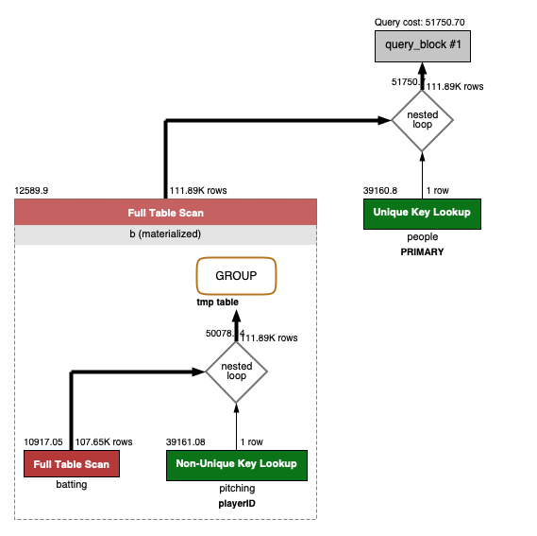
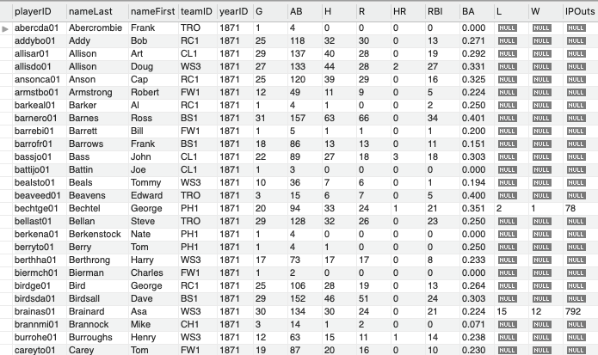
Example
SELECT * FROM lahmansbaseballdb.team_player_year_summary;
Looks like a simple query, but ... is pretty complicated under the covers.
(Show view creating in notebook)

Slide 65
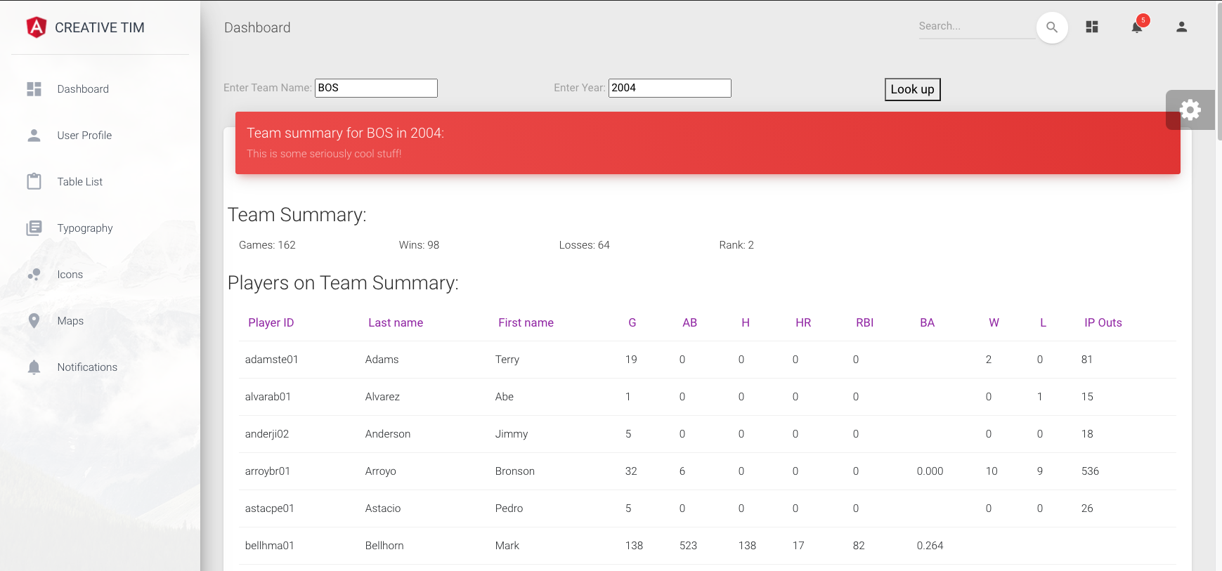
Views
Defining the view enables separation of roles/concerns.
Someone building a web application does not also need to be a SQL expert.
SQL expert provides views that simply development of other components.

Slide 66
View Definition and Use
A view of instructors without their salary
create view faculty as select ID, name, dept_name from instructor
Find all instructors in the Biology department
select name from faculty where dept_name = 'Biology'
Create a view of department salary totals
create view departments_total_salary(dept_name, total_salary) as select dept_name, sum (salary) from instructor group by dept_name;

Slide 67
Views Defined Using Other Views
One view may be used in the expression defining another view
A view relation v₁ is said to depend directly on a view relation v₂ if v₂ is used in the expression defining v₁
A view relation v₁ is said to depend on view relation v₂ if either v₁ depends directly to v₂ or there is a path of dependencies from v₁ to v₂
A view relation v is said to be recursive if it depends on itself.

Slide 68
Views Defined Using Other Views
create view physics_fall_2017 as select course.course_id, sec_id, building, room_number from course, section where course.course_id = section.course_id and course.dept_name = 'Physics' and section.semester = 'Fall' and section.year = '2017’;
create view physics_fall_2017_watson as select course_id, room_number from physics_fall_2017 where building= 'Watson';

Slide 69
View Expansion
Expand the view :
create view physics_fall_2017_watson as select course_id, room_number from physics_fall_2017 where building= 'Watson'
To:
create view physics_fall_2017_watson as
select course_id, room_number
from (select course.course_id, building, room_number
from course, section
where course.course_id = section.course_id
and course.dept_name = 'Physics'
and section.semester = 'Fall'
and section.year = '2017')
where building= 'Watson';

Slide 70
Materialized Views
Certain database systems allow view relations to be physically stored.
Physical copy created when the view is defined.
Such views are called Materialized view:
If relations used in the query are updated, the materialized view result becomes out of date
Need to maintain the view, by updating the view whenever the underlying relations are updated.

Slide 71
Update of a View
Add a new tuple to faculty view which we defined earlier
insert into faculty
values ('30765', 'Green', 'Music');
This insertion must be represented by the insertion into the instructor relation
Must have a value for salary.
Two approaches
Reject the insert
Inset the tuple
('30765', 'Green', 'Music', null)
into the instructor relation

Slide 72
Some Updates Cannot be Translated Uniquely
create view instructor_info as select ID, name, building from instructor, department where instructor.dept_name= department.dept_name;
insert into instructor_info
values ('69987', 'White', 'Taylor');
Issues
Which department, if multiple departments in Taylor?
What if no department is in Taylor?

Slide 73
And Some Not at All
create view history_instructors as select * from instructor where dept_name= 'History';
What happens if we insert
('25566', 'Brown', 'Biology', 100000)
into history_instructors?

Slide 74
View Updates in SQL
Most SQL implementations allow updates only on simple views
The from clause has only one database relation.
The select clause contains only attribute names of the relation, and does not have any expressions, aggregates, or distinct specification.
Any attribute not listed in the select clause can be set to null
The query does not have a group by or having clause.

Slide 75
View Summary
Realization of one of Codd’s Rules: “Rule 5: The comprehensive data sublanguage rule:
A relational system may support several languages and various modes of terminal use (for example, the fill-in-the-blanks mode). However, there must be at least one language whose statements are expressible, per some well-defined syntax, as character strings and that is comprehensive in supporting all of the following items:
Data definition.
View definition.
Data manipulation (interactive and by program).
Integrity constraints.
Authorization.
Transaction boundaries (begin, commit and rollback).”
Views provide several benefits. Three core benefits are:
Enabling queries without exposing sensitive information.
Encapsulation: The underlying data model can evolve without changing apps using views.
Separation of concerns/Bounded complexity: Developers can be productive without being SQL experts. The focus on UI, web application, ... expertise.

Slide 76
Constraints
76 | COMS W4111_002_2021_1: Lecture 4: ER, Relational, SQL (IV) © Donald F. Ferguson, 2021

Slide 77
Integrity Constraints
Integrity constraints guard against accidental damage to the database, by ensuring that authorized changes to the database do not result in a loss of data consistency.
A checking account must have a balance greater than $10,000.00
A salary of a bank employee must be at least $4.00 an hour
A customer must have a (non-null) phone number
Application A
Application B
... ...
... ...
Application N
Note:
Integrating constraints as part of data definition is one of the major benefits.
Eliminates the need to coordinate code in multiple applications.
Move integrity rules
From multiple programs.
To data.

Slide 78
Constraints on a Single Relation
not null
primary key
unique
check (P), where P is a predicate

Slide 79
Not Null Constraints
not null
Declare name and budget to be not null
name varchar(20) not null budget numeric(12,2) not null

Slide 80
Unique Constraints
unique ( A₁, A₂, …, A_{m})
The unique specification states that the attributes A₁, A₂, …, A_{m} form a candidate key.
Candidate keys are permitted to be null (in contrast to primary keys).

Slide 81
The check clause
The check (P) clause specifies a predicate P that must be satisfied by every tuple in a relation.
Example: ensure that semester is one of fall, winter, spring or summer
create table section
(course_id varchar (8),
sec_id varchar (8),
semester varchar (6),
year numeric (4,0),
building varchar (15),
room_number varchar (7),
time slot id varchar (4),
primary key (course_id, sec_id, semester, year),
check (semester in ('Fall', 'Winter', 'Spring', 'Summer')))

Slide 82
Referential Integrity
Ensures that a value that appears in one relation for a given set of attributes also appears for a certain set of attributes in another relation.
Example: If “Biology” is a department name appearing in one of the tuples in the instructor relation, then there exists a tuple in the department relation for “Biology”.
Let A be a set of attributes. Let R and S be two relations that contain attributes A and where A is the primary key of S. A is said to be a foreign key of R if for any values of A appearing in R these values also appear in S.

Slide 83
Referential Integrity (Cont.)
Foreign keys can be specified as part of the SQL create table statement
foreign key (dept_name) references department
By default, a foreign key references the primary-key attributes of the referenced table.
SQL allows a list of attributes of the referenced relation to be specified explicitly.
foreign key (dept_name) references department (dept_name)

Slide 84
Cascading Actions in Referential Integrity
When a referential-integrity constraint is violated, the normal procedure is to reject the action that caused the violation.
An alternative, in case of delete or update is to cascade
create table course ( (… dept_name varchar(20), foreign key (dept_name) references department on delete cascade on update cascade, . . .)
Instead of cascade we can use :
set null,
set default
Note:
I do not use cascading, but that is just my preference.
I believe that changes should be explicit, not implemented behind the scenes.

Slide 85
Integrity Constraint Violation During Transactions
Consider:
create table person ( ID char(10), name char(40), mother char(10), father char(10), primary key ID, foreign key father references person, foreign key mother references person)
How to insert a tuple without causing constraint violation?
Insert father and mother of a person before inserting person
OR, set father and mother to null initially, update after inserting all persons (not possible if father and mother attributes declared to be not null)
OR defer constraint checking
Note: Do not worry about transaction for now.

Slide 86
Complex Check Conditions
The predicate in the check clause can be an arbitrary predicate that can include a subquery.
check (time_slot_id in (select time_slot_id from time_slot))
The check condition states that the time_slot_id in each tuple in the section relation is actually the identifier of a time slot in the time_slot relation.
The condition has to be checked not only when a tuple is inserted or modified in section , but also when the relation time_slot changes
Note:
Not all databases support complex check conditions.
You can use triggers, which we will cover, to implement more complex check constraints.

Slide 87
Assertions
An assertion is a predicate expressing a condition that we wish the database always to satisfy.
The following constraints, can be expressed using assertions:
For each tuple in the student relation, the value of the attribute tot_cred must equal the sum of credits of courses that the student has completed successfully.
An instructor cannot teach in two different classrooms in a semester in the same time slot
An assertion in SQL takes the form:
create assertion <assertion-name> check (<predicate>);
Note: Assertions are inconsistently supported and not that common.

Slide 88
User-Defined Types
create type construct in SQL creates user-defined type
create type Dollars as numeric (12,2) final
Example:
create table department (dept_name varchar (20), building varchar (15), budget Dollars);
Note:
Domains and UDTs are an important concept but not as well supported as they should be.

Slide 89
Domains
create domain construct in SQL-92 creates user-defined domain types
create domain person_name char(20) not null
Types and domains are similar. Domains can have constraints, such as not null, specified on them.
Example:
create domain degree_level varchar(10) constraint degree_level_test check (value in ('Bachelors', 'Masters', 'Doctorate'));

Slide 90
Defining Indexes
90 | COMS W4111_002_2021_1: Lecture 4: ER, Relational, SQL (IV) © Donald F. Ferguson, 2021

Slide 91
Index Creation
Many queries reference only a small proportion of the records in a table.
It is inefficient for the system to read every record to find a record with particular value
An index on an attribute of a relation is a data structure that allows the database system to find those tuples in the relation that have a specified value for that attribute efficiently, without scanning through all the tuples of the relation.
We create an index with the create index command
create index <name> on <relation-name> (attribute);
Note:
MySQL conflates and makes obscure concepts like Key, Constraint and Index.
MySQL Indexes:
Primary
Unique
Index
Full Index
These are actually constraints. Indexes are necessary efficiently enforcing constraints.

Slide 92
Index Creation Example
create table student (ID varchar (5), name varchar (20) not null, dept_name varchar (20), tot_cred numeric (3,0) default 0, primary key (ID))
create index studentID_index on student(ID)
The query:
select * from student where ID = '12345'
can be executed by using the index to find the required record, without looking at all records of student

Slide 93
Some More Set-Like Concepts
93 | COMS W4111_002_2021_1: Lecture 4: ER, Relational, SQL (IV) © Donald F. Ferguson, 2021

Slide 94
Set Comparison – “some” Clause
Find names of instructors with salary greater than that of some (at least one) instructor in the Biology department.
Same query using > some clause
select distinct T.name
from instructor as T, instructor as S
where T.salary > S.salary and S.dept name = 'Biology';
select name
from instructor
where salary > some (select salary
from instructor
where dept name = 'Biology');

Slide 95
Definition of “some” Clause
F <comp> some r ⇔ ∃ t ∈ r such that (F <comp> t ) Where <comp> can be: <, ≤, >, =, ≠
0
(5 < some
5
) = true
(read: 5 < some tuple in the relation)
6
0
(5 < some
5
) = false
0
(5 = some
) = true
5
0
(5 ≠ some
5
) = true (since 0 ≠ 5)
(= some) ≡ in
However, (≠ some) ≡ not in

Slide 96
Set Comparison – “all” Clause
Find the names of all instructors whose salary is greater than the salary of all instructors in the Biology department.
select name
from instructor
where salary > all (select salary
from instructor
where dept name = 'Biology');

Slide 97
Definition of “all” Clause
F <comp> all r ⇔ ∀ t ∈ r (F <comp> t)
0
(5 < all
5
) = false
6
6
(5 < all
) = true
10
4
(5 = all
) = false
5
4
(5 ≠ all
) = true (since 5 ≠ 4 and 5 ≠ 6)
6
(≠ all) ≡ not in
However, (= all) ≡ in

Slide 98
Test for Empty Relations
The exists construct returns the value true if the argument subquery is nonempty.
exists r ⇔ r ≠ Ø
not exists r ⇔ r = Ø

Slide 99
Use of “exists” Clause
Yet another way of specifying the query “Find all courses taught in both the Fall 2017 semester and in the Spring 2018 semester”
select course_id from section as S where semester = 'Fall' and year = 2017 and exists (select * from section as T where semester = 'Spring' and year= 2018 and S.course_id = T.course_id);
Correlation name – variable S in the outer query
Correlated subquery – the inner query

Slide 100
Use of “not exists” Clause
Find all students who have taken all courses offered in the Biology department.
Note that X – Y = Ø ⇔ X ⊆ Y
Note: Cannot write this query using = all and its variants
select distinct S.ID, S.name
from student as S
where not exists ( (select course_id
from course
where dept_name = 'Biology')
except
(select T.course_id
from takes as T
where S.ID = T.ID));
First nested query lists all courses offered in Biology
Second nested query lists all courses a particular student took

Slide 101
Test for Absence of Duplicate Tuples
The unique construct tests whether a subquery has any duplicate tuples in its result.
The unique construct evaluates to “true” if a given subquery contains no duplicates .
Find all courses that were offered at most once in 2017
select T.course_id from course as T where unique ( select R.course_id from section as R where T.course_id= R.course_id and R.year = 2017);

Slide 102
Completing Subqueries
A subquery is a query inside a query.
Logically, the engine calls the subquery when evaluating every row in processing.
Correlation means properties from the outer row being evaluated are inputs to the inner query.
Subqueries:
Return tables if in the FROM clause.
Scalars in the SELECT clause.
Tables or scalars depending on the comparison operator in WHERE.
102 | COMS W4111_002_2021_1: Lecture 4: ER, Relational, SQL (IV) © Donald F. Ferguson, 2021

Slide 103
Subqueries in the From Clause
SQL allows a subquery expression to be used in the from clause
Find the average instructors’ salaries of those departments where the average salary is greater than $42,000.”
select dept_name, avg_salary from ( select dept_name, avg (salary) as avg_salary from instructor group by dept_name) where avg_salary > 42000;
Note that we do not need to use the having clause
Another way to write above query
select dept_name, avg_salary from ( select dept_name, avg (salary) from instructor group by dept_name)
as dept_avg (dept_name, avg_salary)
where avg_salary > 42000;

Slide 104
Scalar Subquery
Scalar subquery is one which is used where a single value is expected
List all departments along with the number of instructors in each department
select dept_name, ( select count(*) from instructor where department.dept_name = instructor.dept_name) as num_instructors from department;
Runtime error if subquery returns more than one result tuple

Slide 105
Functions (Required for HW 2)
105 | COMS W4111_002_2021_1: Lecture 4: ER, Relational, SQL (IV) © Donald F. Ferguson, 2021

Slide 106
Functions and Procedures
Functions and procedures allow “business logic” to be stored in the database and executed from SQL statements.
These can be defined either by the procedural component of SQL or by an external programming language such as Java, C, or C++.
The syntax we present here is defined by the SQL standard.
Most databases implement nonstandard versions of this syntax.
Note:
The programming language, runtime and tools for functions, procedures and triggers are not easy to use.
My view is that calling external functions is an anti-pattern (bad idea).
External code degrades the reliability, security and performance of the database.
Databases are often mission critical and the heart of environments.

Slide 107
Declaring SQL Functions
Define a function that, given the name of a department, returns the count of the number of instructors in that department.
create function dept_count (dept_name varchar(20)) returns integer begin declare d_count integer; select count (* ) into d_count from instructor where instructor.dept_name = dept_name return d_count; end
The function dept_count can be used to find the department names and budget of all departments with more that 12 instructors.
select dept_name, budget from department where dept_count (dept_name ) > 12

Slide 108
Table Functions
The SQL standard supports functions that can return tables as results; such functions are called table functions
Example: Return all instructors in a given department
create function instructor_of (dept_name char(20))
returns table (
ID varchar(5), name varchar(20), dept_name varchar(20), salary numeric(8,2))
return table (select ID, name, dept_name, salary from instructor where instructor.dept_name = instructor_of.dept_name)
Usage
select * from table (instructor_of ('Music'))

Slide 109
(Core) Language Constructs (Cont.)
For loop
Permits iteration over all results of a query
Example: Find the budget of all departments declare n integer default 0; for r as select budget from department where dept_name = 'Music' do set n = n + r.budget end for
Note:
There are various other looping constructs.

Slide 110
(Core) Language Constructs – if-then-else
Conditional statements (if-then-else)
if boolean expression then statement or compound statement elseif boolean expression then statement or compound statement else statement or compound statement end if

Slide 111
Switch to Notebook
Switch to Notebook

Slide 112
Metadata and Catalog
112 | COMS W4111_002_2021_1: Lecture 4: ER, Relational, SQL (IV) © Donald F. Ferguson, 2021

Slide 113
Metadata and Catalog
‘Metadata is "data that provides information about other data". In other words, it is "data about data". Many distinct types of metadata exist, including descriptive metadata, structural metadata, administrative metadata, reference metadata and statistical metadata.’ (https://en.wikipedia.org/wiki/Metadata)
“The database catalog of a database instance consists of metadata in which definitions of database objects such as base tables, views (virtual tables), synonyms, value ranges, indexes, users, and user groups are stored. ... ... The SQL standard specifies a uniform means to access the catalog, called the INFORMATION_SCHEMA, but not all databases follow this ...” (https://en.wikipedia.org/wiki/Database_catalog)
Codd’s Rule 4: Dynamic online catalog based on the relational model:
The data base description is represented at the logical level in the same way as ordinary data, so that authorized users can apply the same relational language to its interrogation as they apply to the regular data.

Slide 114
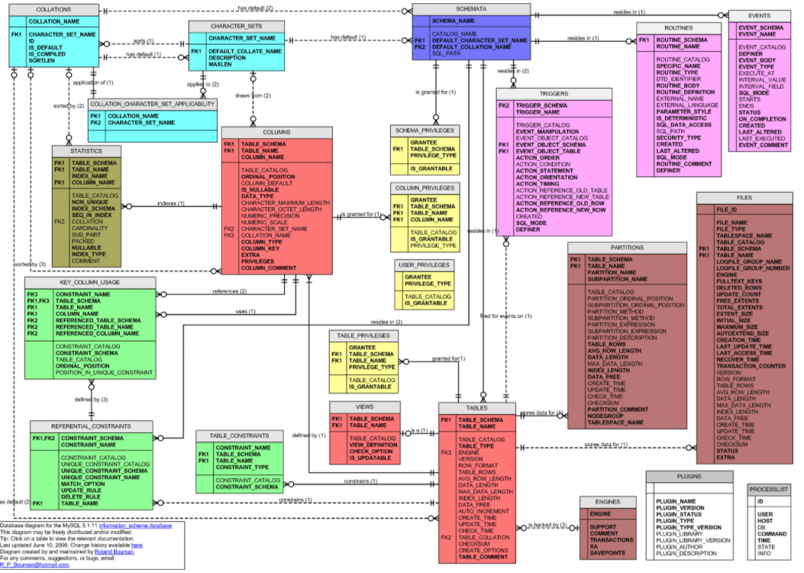
MySQL Catalog (Information_Schema)
Some of the MySQL Information Schema Tables:
'ADMINISTRABLE_ROLE_AUTHORIZATIONS'
'APPLICABLE_ROLES'
'CHARACTER_SETS'
'CHECK_CONSTRAINTS'
'COLUMN_PRIVILEGES'
'COLUMN_STATISTICS'
'COLUMNS'
'ENABLED_ROLES'
'ENGINES'
'EVENTS'
'FILES'
'KEY_COLUMN_USAGE'
'PARAMETERS'
'REFERENTIAL_CONSTRAINTS'
'RESOURCE_GROUPS'
'ROLE_COLUMN_GRANTS'
'ROLE_ROUTINE_GRANTS'
'ROLE_TABLE_GRANTS'
'ROUTINES'
'SCHEMA_PRIVILEGES'
'STATISTICS'
'TABLE_CONSTRAINTS'
'TABLE_PRIVILEGES'
'TABLES'
'TABLESPACES'
'TRIGGERS'
'USER_PRIVILEGES'
'VIEW_ROUTINE_USAGE'
'VIEW_TABLE_USAGE'
'VIEWS'
CREATE and ALTER statements modify the data.
DBMS reads information:
Parsing
Optimizer
etc.

Slide 115
Switch to Notebook
Switch to Notebook

Slide 116
More Complex Entity-Relationship Concepts
116 | COMS W4111_002_2021_1: Lecture 4: ER, Relational, SQL (IV) © Donald F. Ferguson, 2021

Slide 117
Backup
Backup

